Slide 1

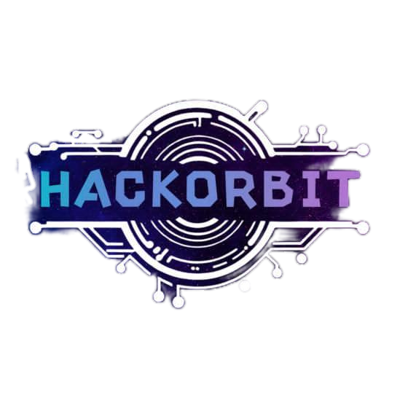


HackOrbit 2025
Tech Heroes

Slide 2

AI & Machine Learning
THEME & PROBLEM STATEMENT
AI & Machine Learning
The Job Seekers Problem
Across universities in India, students work hard for placements, but many still fail to get shortlisted. Their resumes often get rejected by automated systems, they don’t know what skills are in demand, and there's no personalized guidance. Despite potential, countless talented students miss out on opportunities simply because they don’t know how to stand out.
1
Resume Rejection
80% of resumes get auto-rejected before reaching recruiters because of ATS screening
2
Manual Outreach to Recruiters
Job seekers struggle to get noticed or connect with hiring managers often lost in a sea of applications
Rapid Trend Changes
Job trends shift quickly, leaving applicants behind
because there is always a new skill trending in the market
Lack of Guidance
Personalized career growth guidance is missing and it is hard to find good resource for skill development
4
3

Slide 3
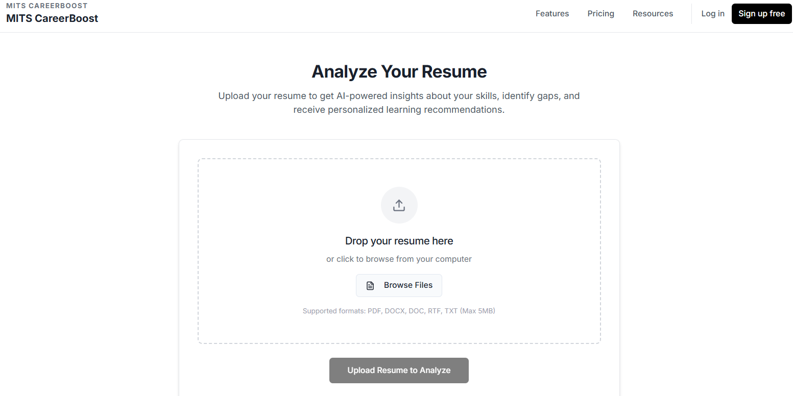
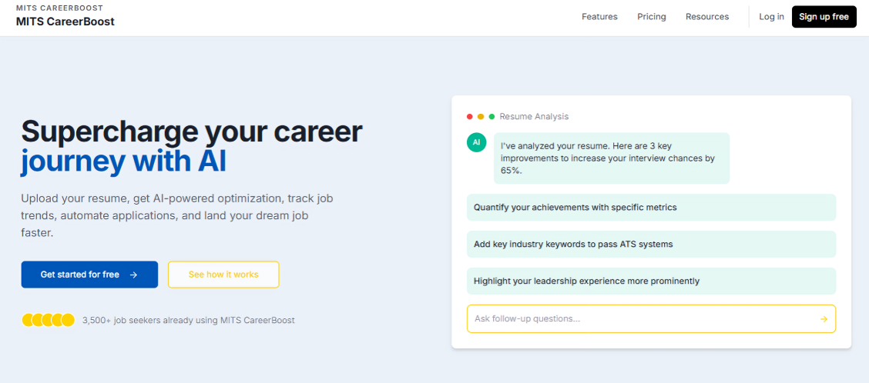


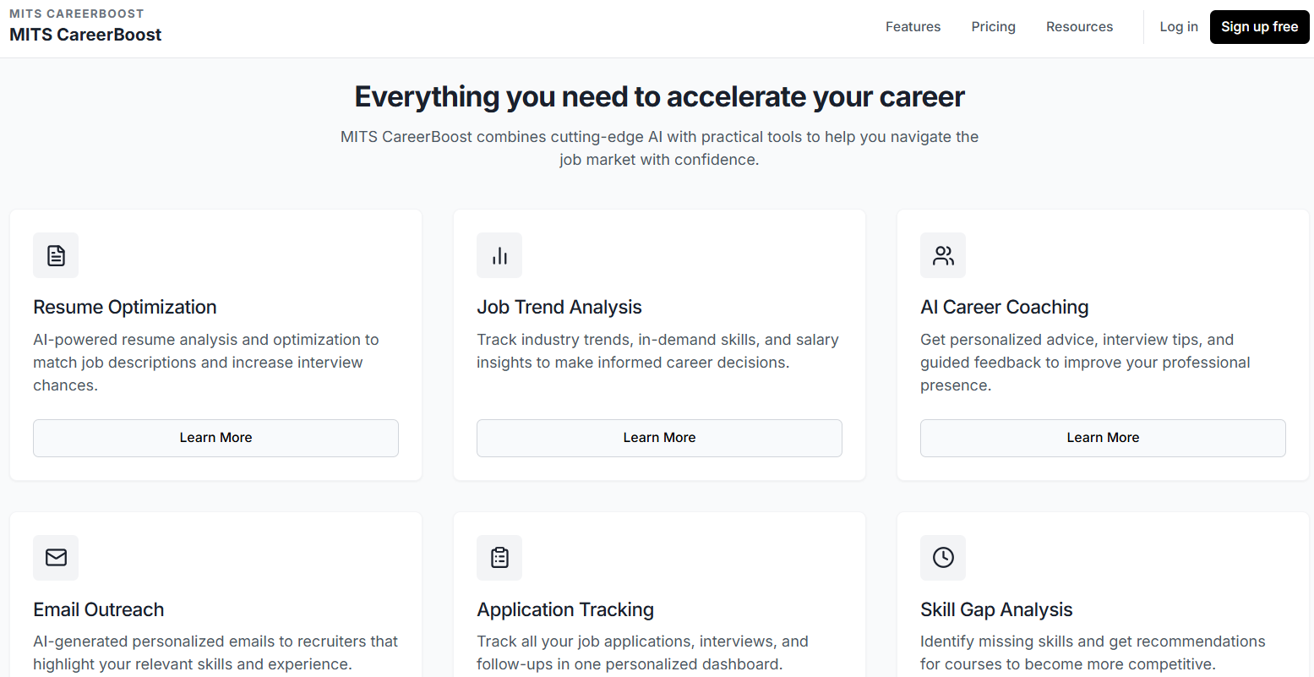


PROPOSED SOLUTION
MITS CareerBoost is an AI-powered career co-pilot that guides students from skill discovery to job offers. Built on the MERN stack, it offers personalized career paths, ATS-optimized resumes, AI interview coaching, and smart job matching. It also enables mentor networking, gamified upskilling, and real-time analytics—helping students reach the right opportunities at the right time.
Job Trend Prediction Predicts in-demand skills and job openings ahead of time
Resume Optimization
Tailors resumes to beat ATS
systems using AI
AI Coaching
Recommends courses and tools
based on user goals & trends
Auto-Email Outreach: Sends personalized emails to recruiter automatically
Let’s not just help people find jobs—let’s help them build futures.

Slide 4
Initial Setup
Sign Up & Profile Creation Resume
Upload & Skill Assessment AI
Career Path Generation Skill Gap
Core Process
Analysis & Upskilling
Recommendations Job/Internship
Matching & Application Kit
Advancement and Growth
Generation Mock Interview &
Feedback Mentorship & Networking
Progress Tracking & Analytics
Flowchart

Slide 5
FLOWCHART / DIAGRAM
Tier 1: Setup & Assessment
🔹 User Sign-Up & Profile Creation
🔹 Resume Upload + AI Skill Analysis
🔹 Career Path Generation (Skill Gap Identification)
Tier 2: Matching & Upskilling
🔹 Job Market Analysis & Personalized Upskilling
🔹 AI-Powered Job/Internship Recommendations
🔹 Auto-Generated Application Kits
Tier 3: Advancement & Growth
🔹 Mock Interviews with Real-Time Feedback
🔹 Mentorship & Networking Connections
🔹 Progress Dashboard with Analytics & Predictive Insights

Slide 6
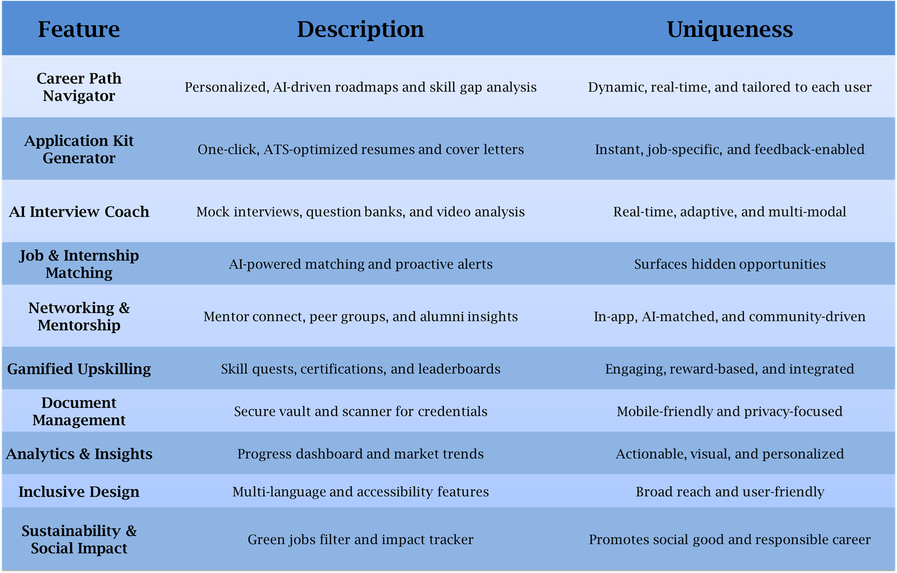
FEATURES AND NOVELTY

Slide 7
DRAWBACK AND SHOWSTOPPERS
Reliance on third-party free tools may limit customization.
Internet connectivity required for most features.
Some advanced AI features may have usage limits on free tiers.

Slide 8
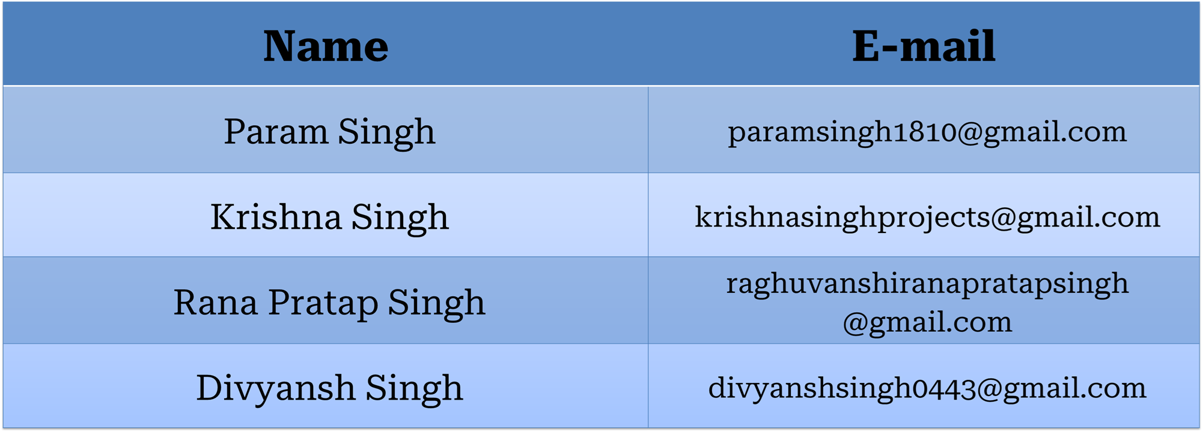
TEAM NAME
Name of team members and their contact details

Slide 9
Thank you

